Slide 1
Black Cat Studios Presents
Piazza Panic
By Jack Vickers, Jack Hinton, Sam Toner, Azzam Bahri, Hubert Solecki and Felix Seanor

Slide 2
What Makes our Game Special

Slide 3
Quick Points
Very few bugs/well tested - as far as we can tell!
Requires very few lines of code to add new objects in
Code reuse is very easy
Is very easy to expand onto
Very easy to play sfx
Contains features useful for the next part
No need to make systematic changes in the game
E.g. to groups automatically walk to the table with correct spaces
Fully commented
Testable

Slide 4
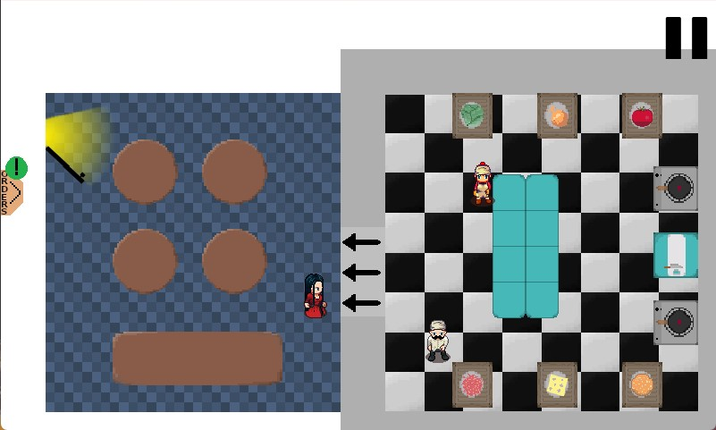
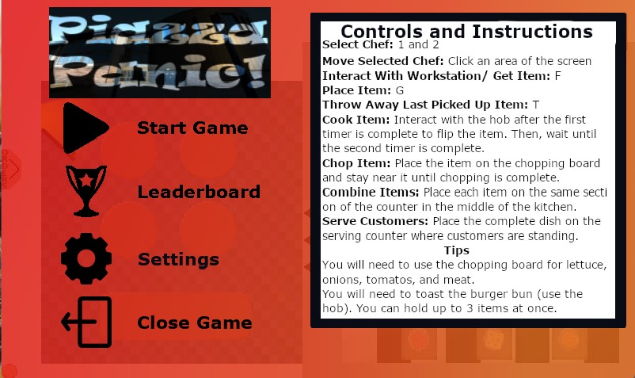
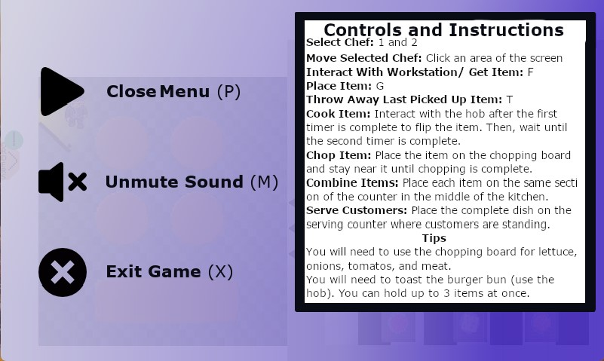
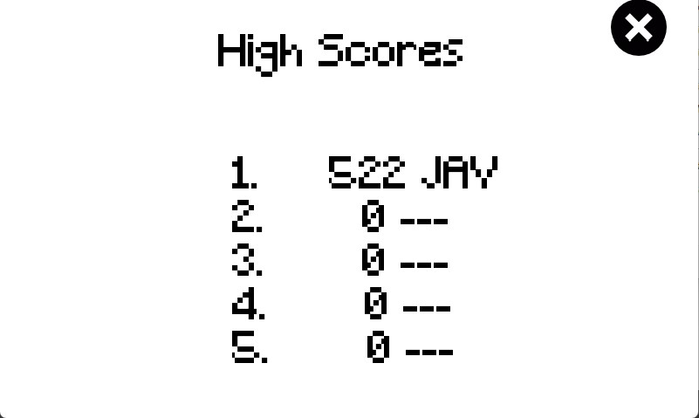
Menu System
In-built, reusable functions in GameObject class such as object clicking and button pressing
Buttons/GameObjects are images; easily modifiable for style and implementation
GIMP files included in assets folder so buttons can be changed and exported as images

Slide 5
Workstations
Several types of workstations i.e. Chopping board, Counter, Hob and Serving Counter
Food burning can easily be implemented in hob
All base functions can be copied and adjusted for needs when making a new workstation
Only two recipe steps needed, which can be used on all workstations, through the use of a recipe whitelist

Slide 6
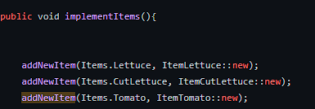
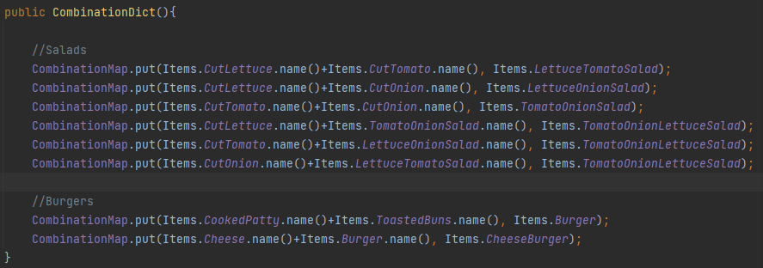
Food Combinations and Item Factory
Item constructors can be called through a dictionary
New combinations can be easily added
The key is made up of both items names concatenated in order of their enum values
Supports “half-items”

Slide 7
Game Object
Our Game Engine uses a GameObject system similar to unity
Creating a new GameObject is as simple as
With a lot more overrides allowing for precise control

Slide 8

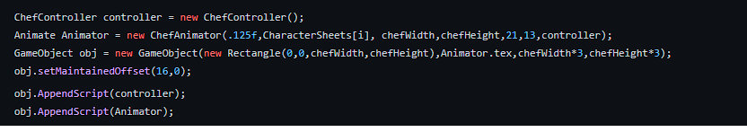
Script Composition System
We use a script composition system promoting code reuse similar to the Unity Game Engine

Slide 9
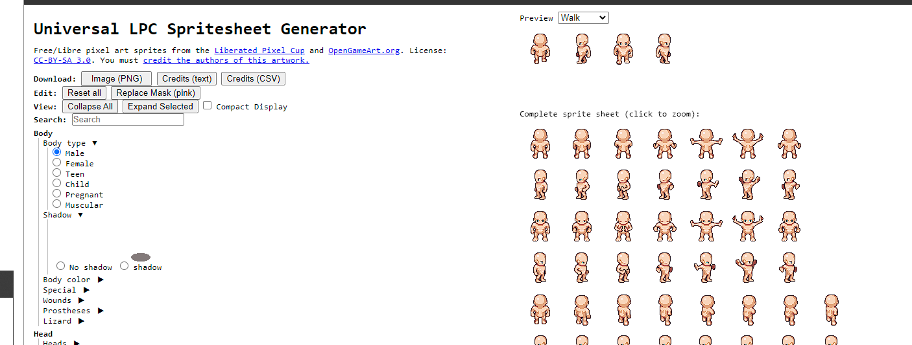
Animation Studio
We’ve created an animator for your use
The scripts such as ChefAnimator and CharacterAnimator, will work on attachment
New customer or chefs can be created either by hand or we support this generator

Slide 10
A* Pathfinding
Game uses A* pathfinding to move chefs, and supports adding new objects into the world and new chefs very easily

Slide 11
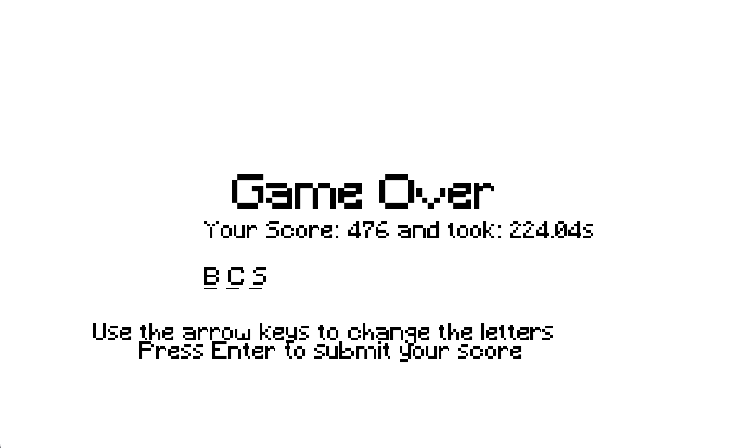
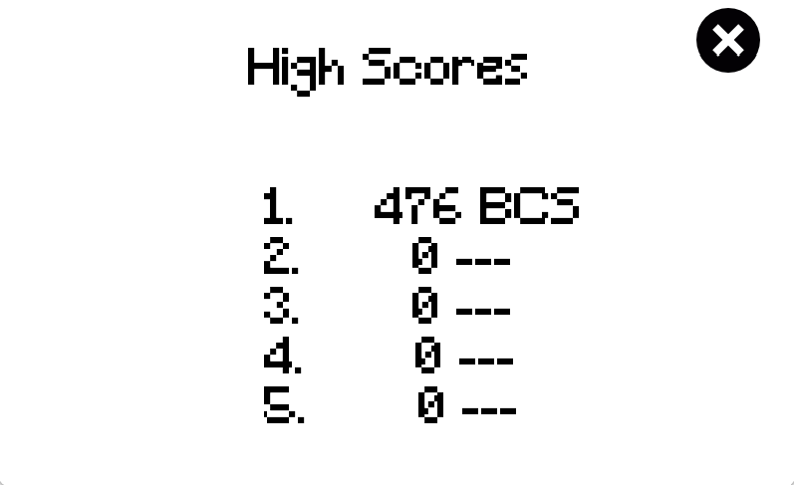
Additional feature: High Scores
High scores is already implemented and is done by reading and writing on the json file called ‘highscores.json’.
Can easily be modified to be made from inserting three characters only to inserting full name.

Slide 12
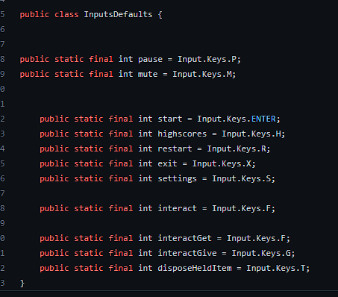
Unified Controls
All control inputs found in one file

Slide 13
Feature Complete
All the features required for assessment 1 have been implemented
Extra features (leaderboard, sound, pause functionality) have also been implemented

Slide 14
These slides can be found on our website

Slide 15
And now a demo from our lovely assistant

Slide 16
Any questions?
Our emails can be found in the github repository. Feel free to email us

